Slide 1
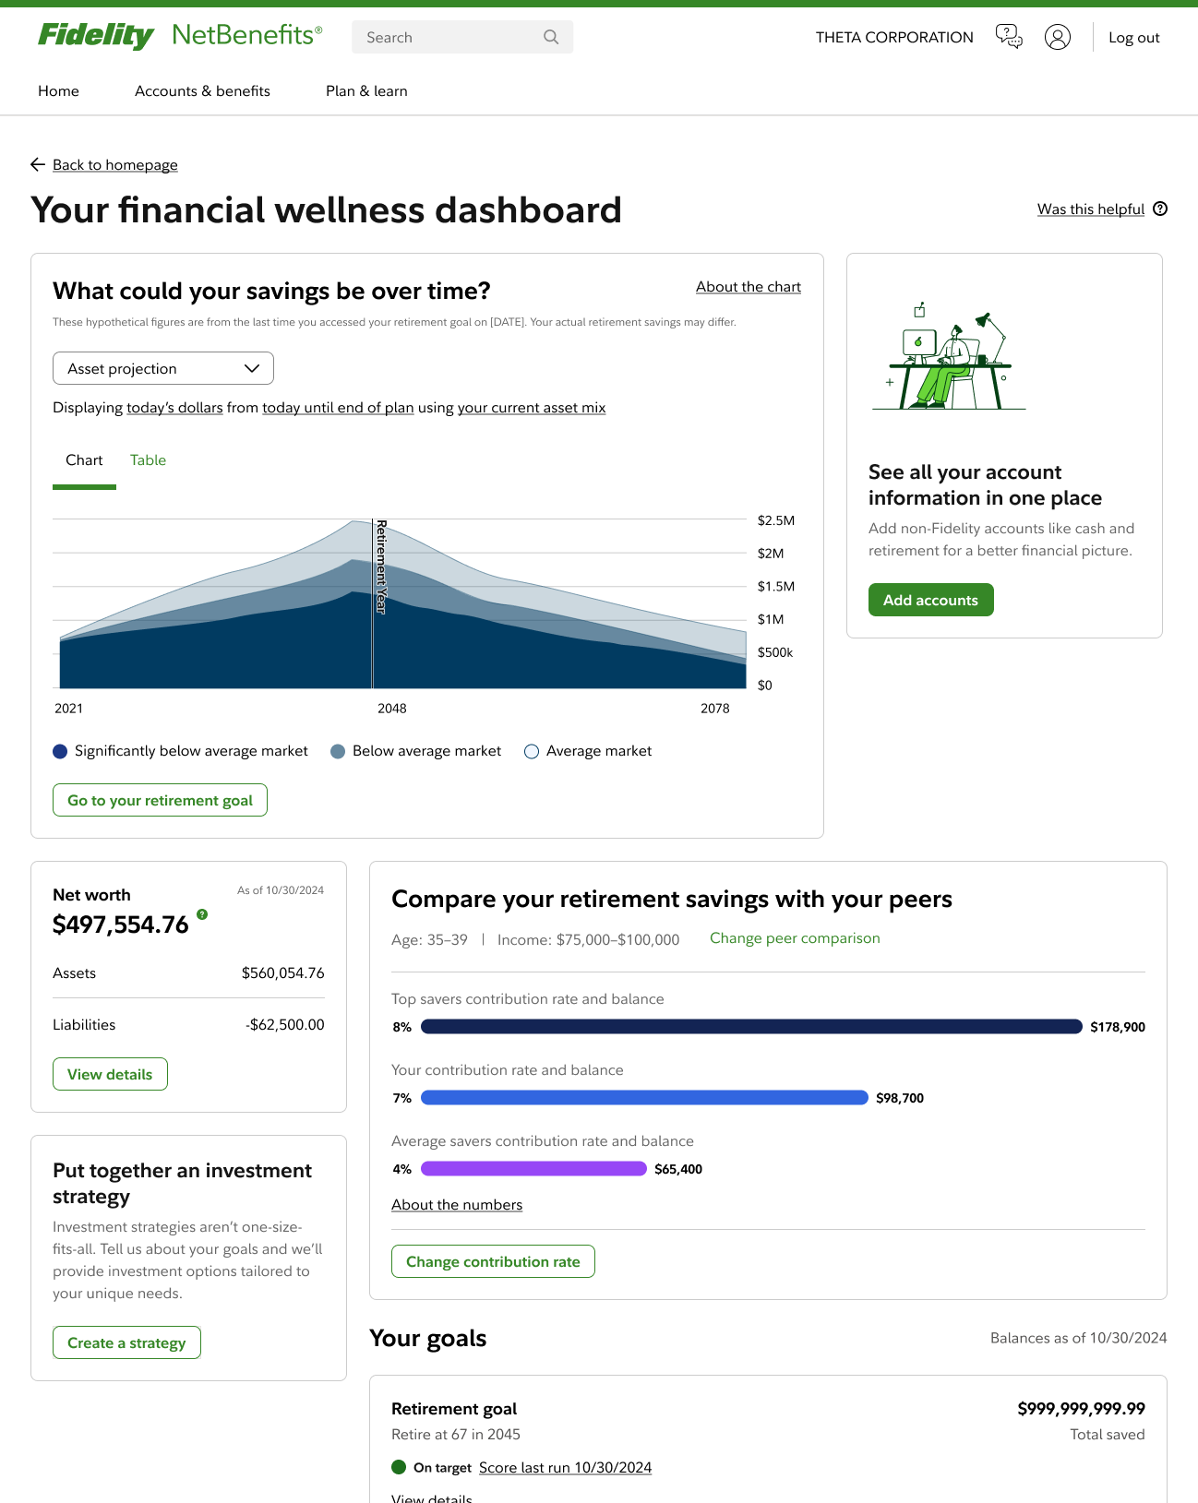
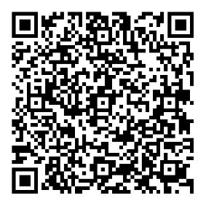
Your financial wellness dashboard
Take charge of your money with financial help that evolves with you
Keeping track of your money is easier with the right tools.
Your Financial Wellness Dashboard has tools, tips,
and help when you need it—all in one place on NetBenefits®.
Simple.
SCAN to get started.
Hover your phone’s camera over the code.
No app needed.
Investing involves risk, including risk of loss.
Screenshot is for illustrative purposes only.
IMPORTANT: The projections or other information generated by the Planning & Guidance Center's Retirement Analysis regarding the likelihood of various investment outcomes are hypothetical in nature, do not reflect actual investment results, and are not guarantees of future results. Your results may vary with each use and over time.
Fidelity Brokerage Services LLC, Member NYSE, SIPC, 900 Salem Street, Smithfield, RI 02917
©2025 FMR LLC. All rights reserved.
1191763.1.0

